Slide 1
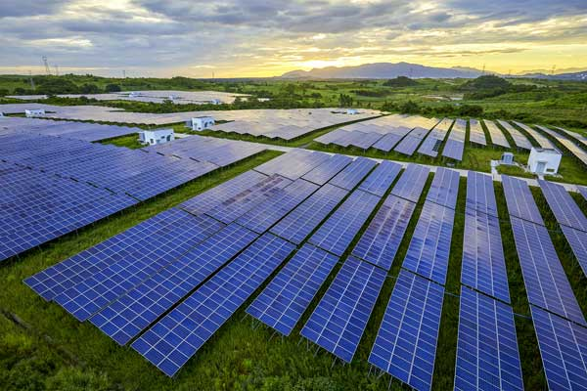

Solar World
By: Nanda Rajaraman

Slide 2
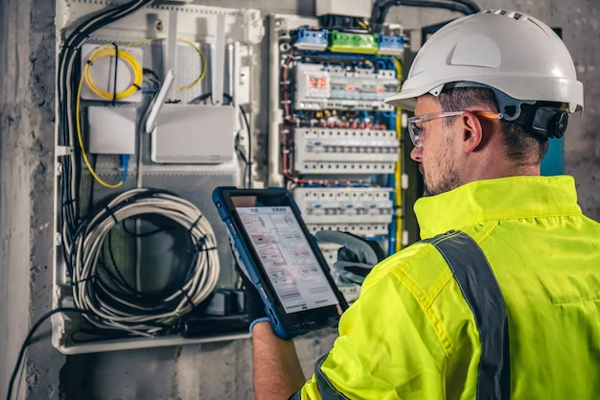

Imagine!
Pursuing a Greater Purpose
Technological Advances Driving the Solar Power Movement
Nurturing Smart Minds

Slide 3
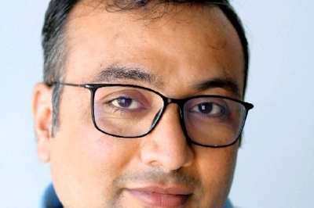

Greater Purpose
Turn sunlight into usable energy
Combined efforts of the electrical engineering community make this possible
Clean up the world
Prerak Kumar Shah, Senior Electrical Engineer at Sonnen Inc.

Slide 4
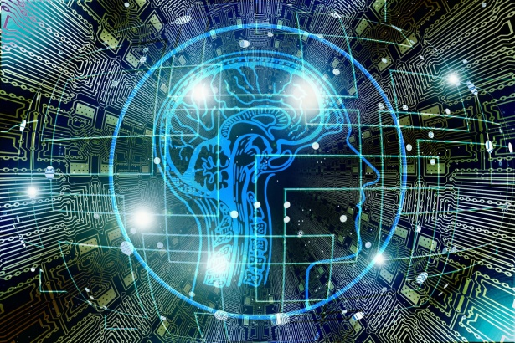

Artificial Intelligence
AI is boosting productivity
Slow change to renewable energy
Speeding up technological processes

Slide 5
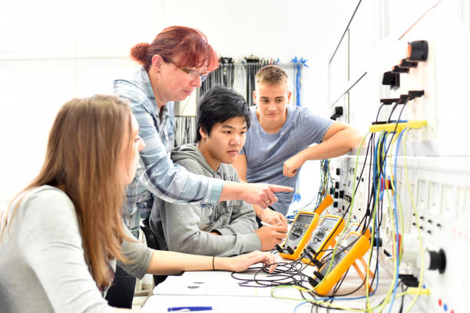

Smart Minds
Field Experience
Technical Job Opportunities
Mixture of Skills

Slide 6


Future
Sustainable Reality
Sharp Technical Minds

